Slide 1

The Silent Disease: Unveiling Hidden Health Risks
Discover the power of our AI-Powered Health Risk Analyzer, an intelligent system meticulously designed to detect subtle, often hidden, health risks before they escalate.
Team Name - Yakuza
Github repo - https://github.com/ByteQuest-2025/GFGBQ-Team-yakuza

Slide 2

The Urgent Need for Proactive Detection
Subtle Symptoms, Severe Outcomes
The Cost of Late Detection
Delayed identification can lead to severe health complications, significantly impacting patient prognosis and quality of life.
Silent diseases often manifest with minimal or ambiguous symptoms, making early diagnosis challenging.
The Call for AI Intervention
There is a critical need for proactive, AI-based analysis to identify potential health risks much earlier.

Slide 3






Our Innovative Solution: AI-Powered Health Guardian
Real-time Lifestyle Insights
Analyzing daily metrics to provide immediate, actionable health data.
AI-Powered Risk Analysis
Leveraging advanced algorithms to identify complex health patterns.
Intelligent Health Companion
A personalized AI assistant guiding users towards better health.

Slide 4





Unlocking Core Capabilities
Interactive Health Dashboard
AI Risk Analysis (Groq Llama-3)
A centralized, intuitive hub for all personal health data and visualizations.
Cutting-edge AI, powered by Groq Llama-3, for in-depth risk assessments.
Persistent AI Chatbot
Secure JWT Authentication
An always-available AI assistant for queries, guidance, and support.
Robust security protocols to protect sensitive health information.

Slide 5
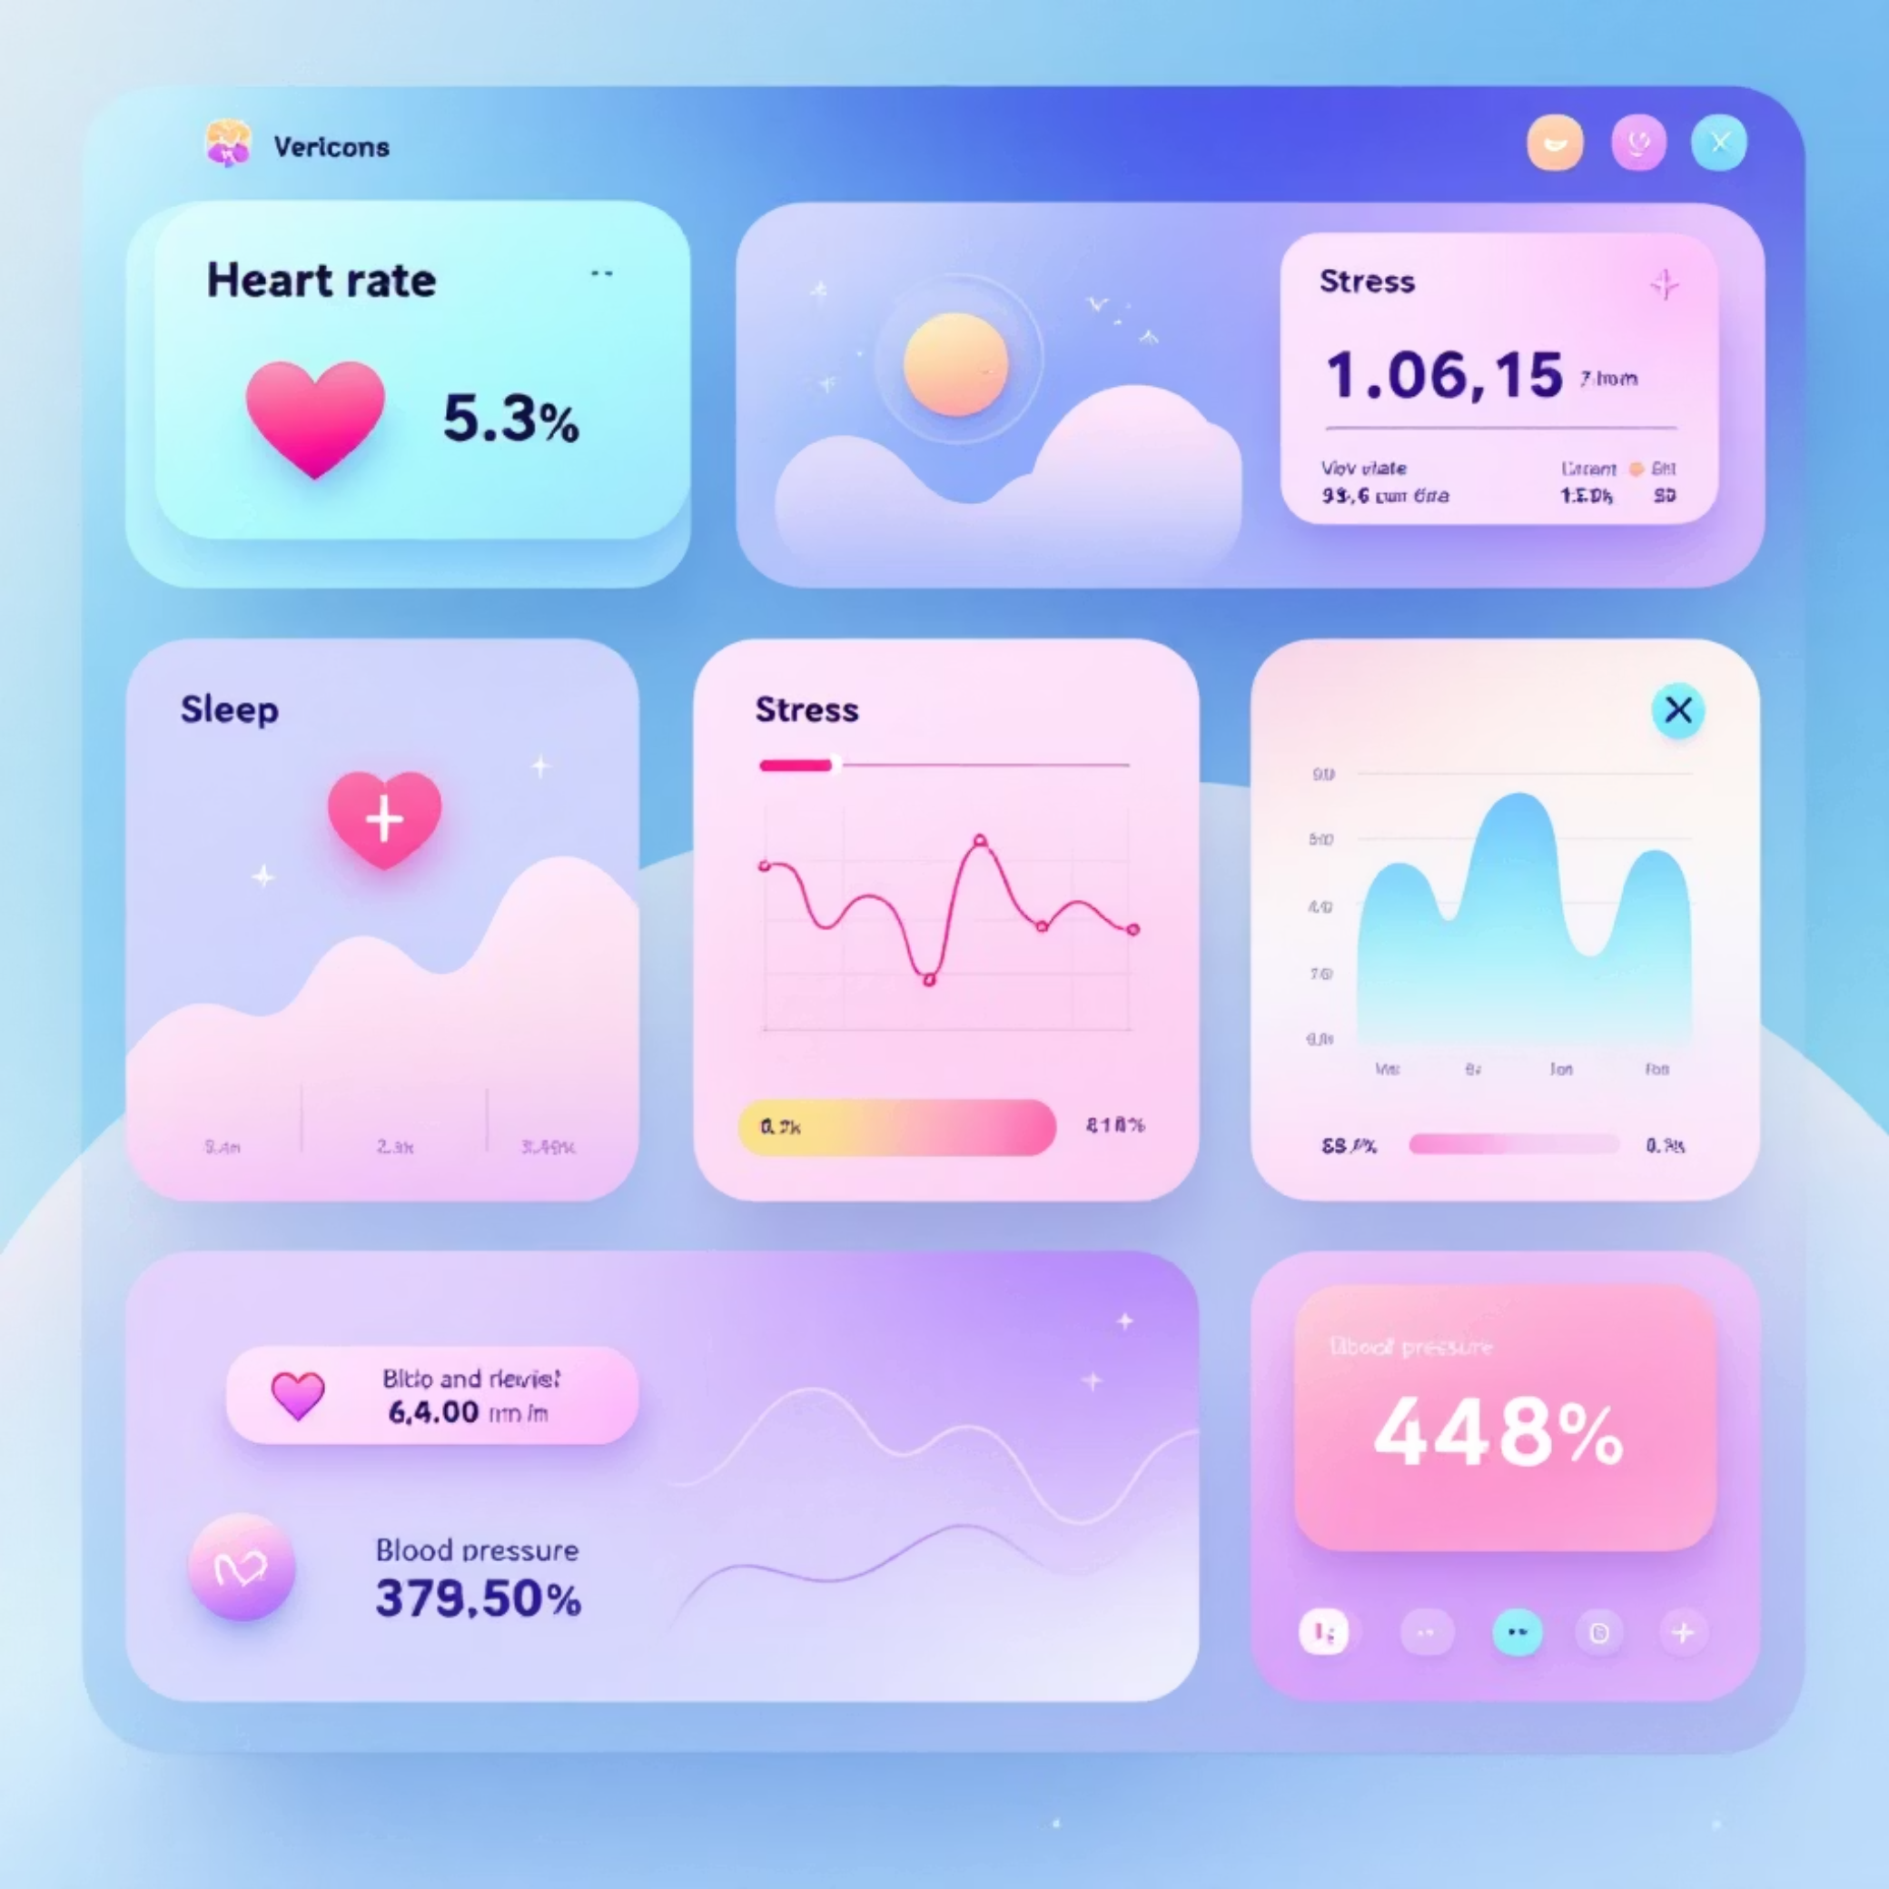
Personalized Dashboard & Advanced Analytics
Comprehensive Health Tracking
Monitors vital signs: heart rate, sleep patterns, stress levels, and blood pressure.
Visualizes trends and anomalies using dynamic charts powered by Recharts.
Features a live risk gauge for immediate health status assessment.

Slide 6




Intelligent AI Risk Analysis: Beyond the Obvious
Advanced Pattern Detection
Identifies subtle, complex patterns in your health data that human observation might miss.
Intuitive Symptom Understanding
Interprets diverse health inputs to understand potential symptom correlations.
Context-Aware Health Reports
Generates personalized, actionable reports with context relevant to your unique health profile.

Slide 7



Our Robust Technological Foundation
Frontend Excellence
Powerful Backend
Cutting-Edge AI Integration
Built with React for dynamic user interfaces, TypeScript for robust code, and Tailwind CSS for sleek design.
Leverages Node.js and Express for efficient server-side operations, with MongoDB for flexible data storage.
Integrates Groq Llama-3 for advanced, high-performance artificial intelligence capabilities.

Slide 8

Unwavering Security & Seamless Personalization
JWT Authentication
Ensuring secure access and protecting sensitive user data.
Personalized Profile Management
Tailored user experiences and customizable health settings.
Mobile-Responsive UI
Seamless experience across all devices, from desktop to mobile.

Slide 9
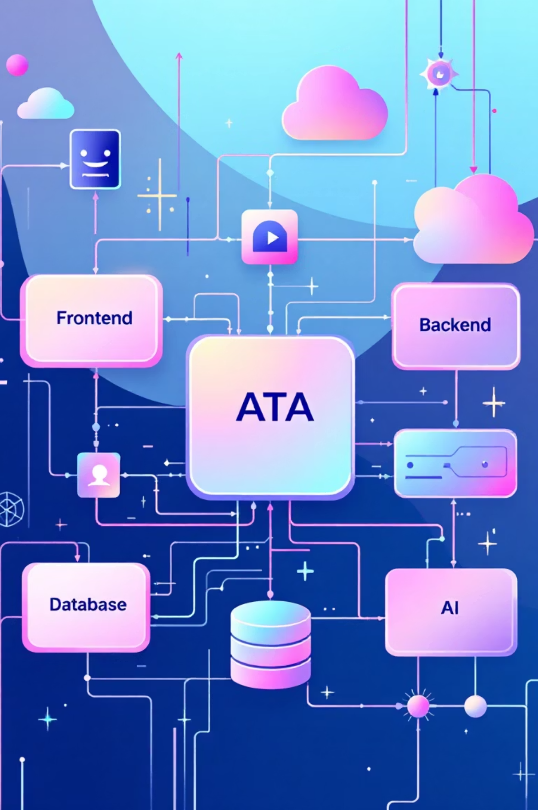

Streamlined Project Architecture
Groq AI
React Frontend
AI analysis integrated
User interface and requests
Streamlined Project Architecture
MongoDB
Express API
Persistent data storage
Handles logic and routes
Our robust architecture ensures seamless data flow and efficient processing, integrating cutting-edge AI for superior health analysis.

Slide 10



Empowering a Healthier Future
Early Detection Saves Lives
Our solution champions proactive health management, shifting from reactive treatment to preventative care.
AI-Assisted Health Awareness
We foster a new era of health consciousness, empowering users with intelligent insights and personalized guidance.
Future-Ready Healthcare Solution
This innovative platform sets the benchmark for the next generation of healthcare technology, adaptable and scalable.

